Slide 1

Hunting Secrets in Code

Slide 2

~# whoami
Ayush
DevSecOps Engineer @appseccouk
Winja CTF Co-Organizer

Slide 3
Outline
Challenges in Secrets Management
Necessity of Secrets Scanning
Impact of Leaked Secrets
Available Tools
Tools
Features
Metrics
Automation
GitHub Actions
Integration with Existing CI/CD Setup
Miscellaneous

Slide 4
Challenges in Secrets Management

Slide 5
How do Secrets get Leaked (in Code)?
Striving for Automation of Operations/Actions
Embedding credentials/sensitive information in Code
"Git never forgets"

Slide 6
Why Scan for Secrets?
Backbone of Authentication and Authorization
Who can I impersonate?
What can I access?
Reduce Attribution
Created ambiguity with accountability
Create issues for incident response

Slide 7
What can happen is Secrets are Leaked?
Account Takeovers
Crypto-Mining
Monetory Damage
"Denial of Wallet" Attack

Slide 8
Available Tools

Slide 9
Do I need to write a scanner to check my code?
No!

Slide 10
What are some Scanners to check my code?
Some secrets scanning tools:
Git-secrets
TruffleHog
Gitleaks
Detect-secrets
Talisman
And many more...

Slide 11
Proactive Actions

Slide 12
Do I need to run a scan before I push my Code?
Need to? No.
Automated Scans
Integrated Scans in Deployment Pipelines
Periodic Scans
Should you? Yes. (We'll get back to this later)

Slide 13
Do I need to pay for a CI/CD Server for running scans?
No!
(Unless you want to)

Slide 14

Do I need to pay for a CI/CD Server for running scans?
To the rescue...

Slide 15
Implementing Scanning on GitHub Actions
Write a Workflow
Create ".github/workflows/" in the Project's root directory
Commit Workflow to the above directory
Trigger the required event

Slide 16
A Sample Workflow
name: TruffleHog Scan
on:
push:
branches: [ master ]
jobs:
scan:
runs-on: ubuntu-18.04
steps:
- uses: actions/checkout@v2
- name: Setting up Python 3.x
uses: actions/setup-python@v1
with:
python-version: '3.x'
- name: Installing TruffleHog
run: pip install trufflehog
- name: Running TruffleHog
run: trufflehog <Git Repository URL>

Slide 17

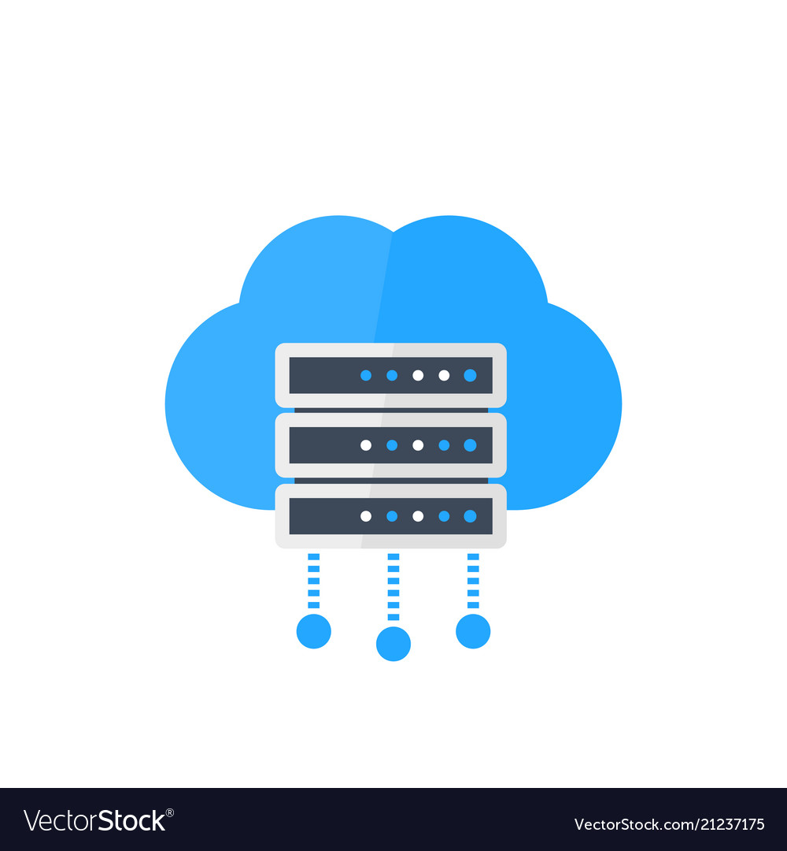


Implementing Scanning with Existing CI/CD Setup
1
2
3
3
4

Slide 18
Other ways of Mitigation

Slide 19
Other Mitigation Methods
Pre-commit Hooks
Pre-push Hooks
Push Rejection

Slide 20
Why does everyone not use Git Hooks already?
Git Hooks
Individual Developer's Discipline
Central Scanning
Easier to Implement and Manage

Slide 21
Thank You!

Slide 22





Questions?
/ayushpriya10 /in/ayushpriya10
@ayushpriya10 @ayushpriya10
@ayushpriya10

